Slide 1


Vue + Pinia
Phearun Chhun

Slide 2
Definition
Pinia is the official state management library for Vue3. Pinia is the store for composition API.
Why we use Pinia?
Devtools support
A timeline to track actions, mutations
Time travel and easier debugging
Modify your stores without reloading your page
Keep any existing state while developing
Plugins: extend Pinia features with plugins
Proper TypeScript support or autocompletion for JS users
Server Side Rendering Support

Slide 3
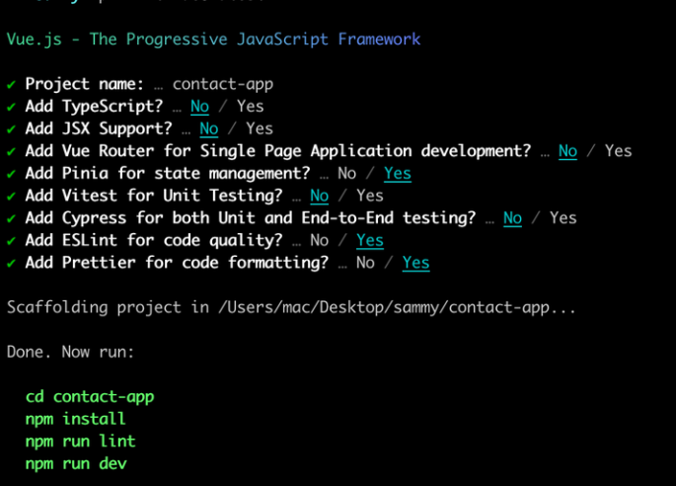
Installation
To setting up the project
npm init vue@latest
To run app
npm run dev
To installing the project dependencies
npm install

Slide 4
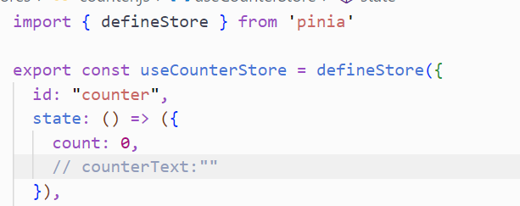
Core Concepts
Defining a store
Before diving into core concepts, we need to know that a store is defined using defineStore() and that it requires a unique name, passed as the first argument:

Slide 5
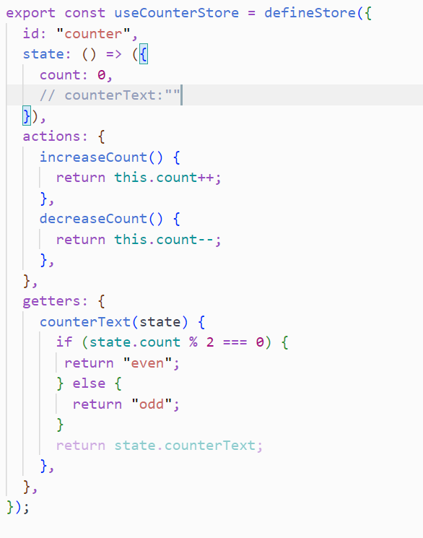
Core Concepts
Options stores
Similar to Vue’s Option API, we can also pass an Options Object with state, actions, and getters properties.
You can think of state as the data of the store, and getters as the computed properties of the store, and actions as the methods.

Slide 6
References
Reference:
https://pinia.vuejs.org/introduction.html#basic-example
https://codesource.io/introducing-pinia-vuejs-new-state-management-solution/

Slide 7
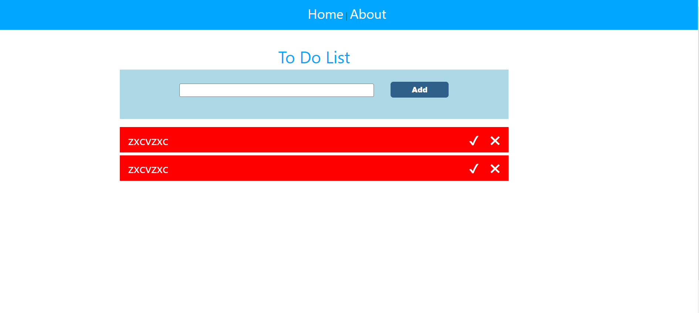
Demo project

